Slide 1
IBM DATA SCIENCE PROFESSIONAL COURSE-9
Capstone Project - The Battle of Neighborhoods
Assignment(Week 2)
Submitted by:-
Manish Bhatia
Email :- manish.bhatia14@yahoo.com
LinkedIn:-www.linkedin.com/in/manish-bhatia-

Slide 2
INTRODUCTION
Unification of Restaurants based on Cuisine type in Downtown TORONTO, Canada and suggesting optimum cluster to Open an Indian Restaurant
Toronto city in Canada is one of the most multicultural & lively cities in the world, this is the reason Toronto comes in Top 10 best cities to live in and attract a lot of tourists from all over the Globe. The city is famous of beautiful lakes, sceneries and outdoor life. The one major characteristic of this city is that it is having more than 50% population which are migrated from outside of Canada.
This has resulted in diverse food choices of people who are living here or the tourists who usually visit in seasonal time. Due to this there are around 7500 restaurants of different cuisine styles are opened like German, Italian, Japanese, Indian, Asian and so on.

Slide 3
PROBLEM STATEMENT & Data Used
In this project we will analyze most famous area ‘Downtown Toronto’ of Toronto city using its demographics characteristics and will visualize which specific cuisine restaurants are most common in certain neighborhoods using clustering methodology so that tourists could plan the trip based on their food choices and, we will try to identify the neighborhoods where an Indian restaurant could be opened based on existing restaurant number and food style priorities.
Data used
Geospatial Data-Weblink
Foursquare API
Demographic information of Toronto city-Wikipedia
Information about the ‘Postal codes’, ‘Boroughs’ and ‘Neighborhoods’ of Toronto city -Wikipedia

Slide 4
Methodology
Data Extraction from the links shared in Reference sheet.
Cleaning and preprocessing the data to convert into usable format.
Performing Exploratory analysis on extracted Restaurant information from foursquare API
Running Clustering algorithm using KMEANS.
Analyzing Results and recommendation for Business problem
Data Extraction
Data Cleaning and preprocessing
Performing EDA on the extracted Restaurant information from foursquare API
Clustering construction using KMEANS clustering algorithm
Analyzing Results and recommendation for Business problem.

Slide 5
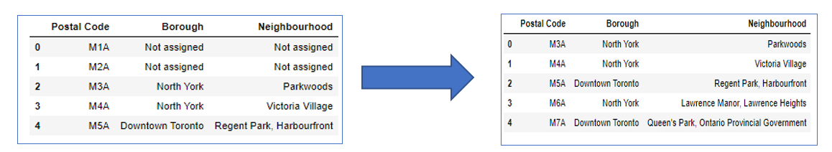
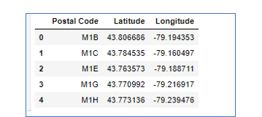
Data Extraction and Processing
Initial data cleaning analogy to convert the data into usable form.
filtering out the tables from wiki webpage, Selection of certain columns like postal code, Borough and Neighborhood
Cleaning the data by removing non informational values from Borough & Neighborhood columns
Extracting Geospatial Data

Slide 6
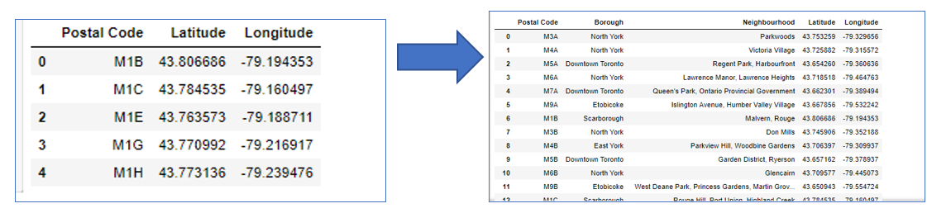
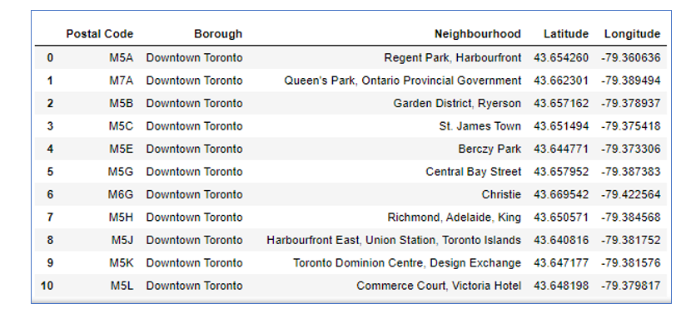
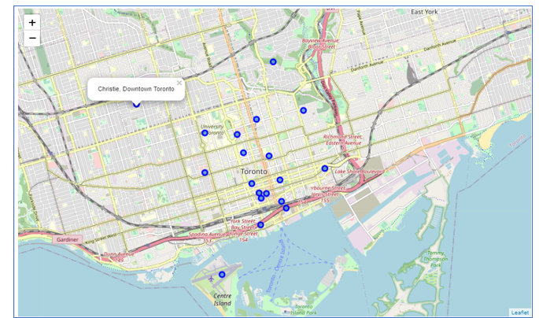
Data Extraction and Processing contd..
Merging the tables to convert data into desirable format like below
Filtering Downtown Toronto from Borough on which our problem statement was to be analyzed and plotting on map using Folium Library

Slide 7
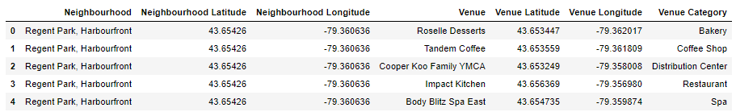
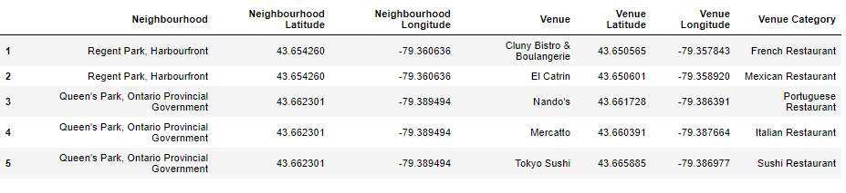
Data Extraction and Processing contd..
Next step was to explore nearby venues in Downtown Toronto Using FOURSQUARE API, below table was extracted.
After this, filtered out the Restaurants from venue category , results as shown below

Slide 8
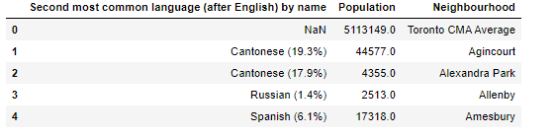
Data Extraction and Processing contd..
Next step was to extract demographic information from Wikipedia page for Toronto city. As the data was not clean so cleaning process was performed by modifying the neighborhoods and converting the names in a format which was matching with Toronto neighborhood data.

Slide 9
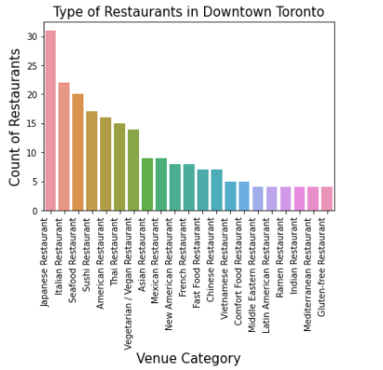
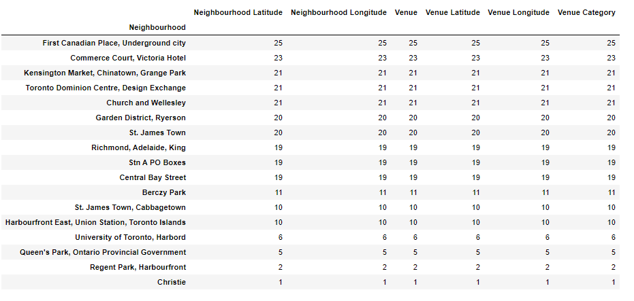
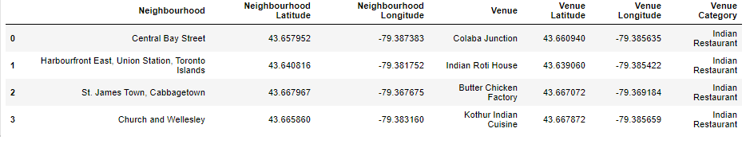
Exploratory Data analysis
EDA was performed to identify restaurants which are highest in Downtown Toronto area and average occurrence of each restaurant.
Data was further filtered out to check which neighborhoods were having Indian restaurants

Slide 10
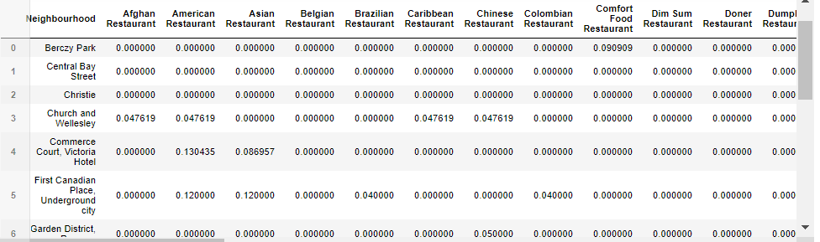
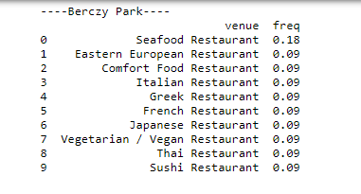
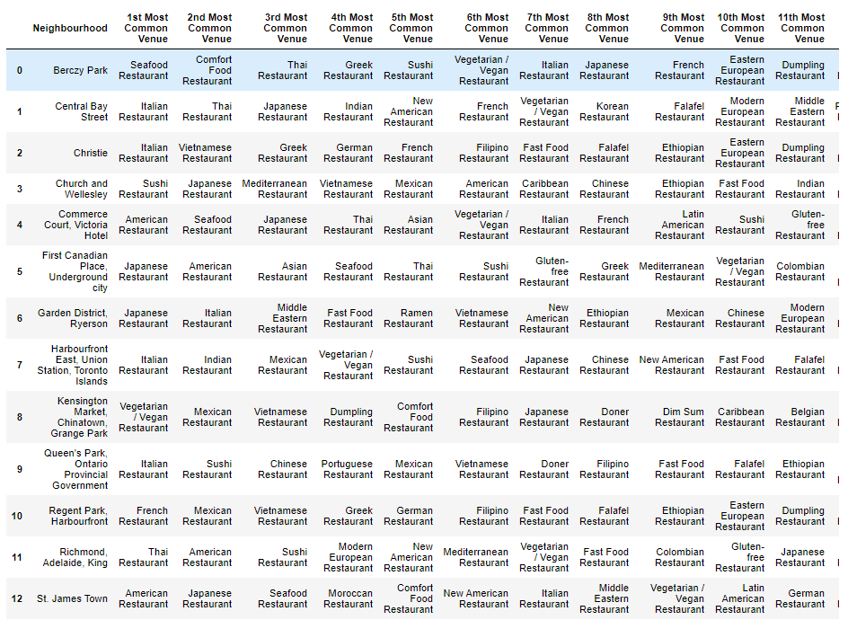
Exploratory Data analysis contd..
Neighborhoods were also grouped to see average(mean) occurrence of each type of restaurant in the specific neighborhoods
Restaurants were sorted out based on their highest occurrence and most common venues in the neighborhood.

Slide 11
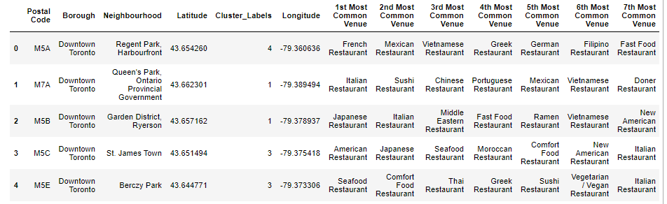
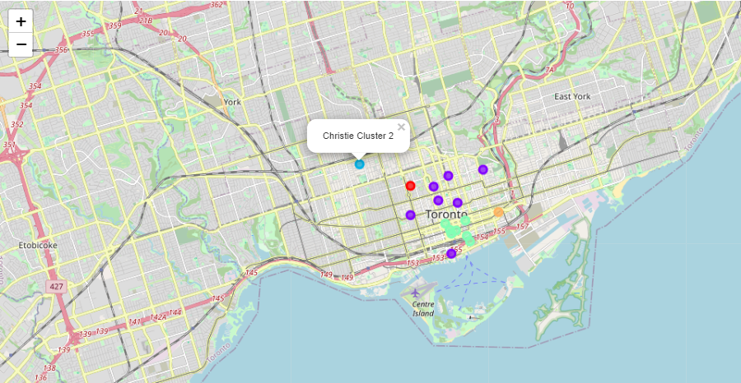
Clustering machine learning algorithm implementation
After analyzing each scenario of extracting highest number of restaurants, Clustering machine algorithm was applied on the database to group the neighborhoods in relation with most common restaurants in each specific area.
By analyzing the neighborhood information, Clusters were divided into 5 categories, this was set using value of Kmeans.
The grouped clusters created using machine learning were also presented on ‘Downtown Toronto’ map to check geographical information of the clusters. This was performed using ‘Folium library’.

Slide 12
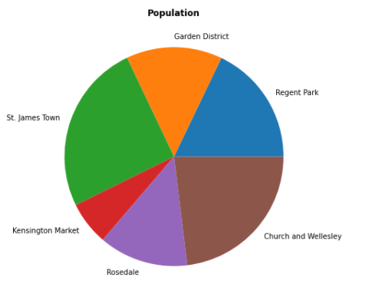
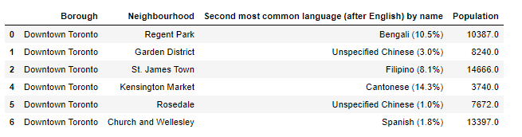
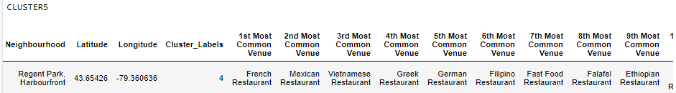
Exploratory data analysis on demographic data
After cleaning and processing the tables, data was merged with Toronto neighborhood data to extract information of Population, most common language being spoken in the specific neighborhoods. Now the output of the table as shown below was mapped with grouped clusters which were created using machine learning algorithm to identify which specific cluster and neighborhood are having many restaurants, but any ‘Indian Restaurant’ is not in even top 15 restaurants, The filtering results were mapped with the Neighborhoods where second most common language being spoken was of Indian community and the population was in mid or high category.
Here in cluster 5 There is no Indian restaurant in Regent park area, but the most spoken language is ‘Bengali’

Slide 13
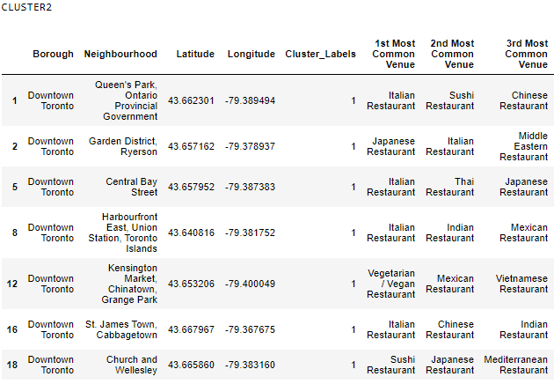
Discussion & recommendation
After performing Exploratory data analysis and visualization techniques on extracted datasets, it was observed that in Downtown Toronto there are variety of Cuisine choices available , Also as there is more than 45% of population migrated from all around the globe, Toronto city is one of the best choices where Tourists from every community can visit and live here. From the data analyzed it was noticed that there are 2 Clusters (Cluster 2 and 4) which should be in the first to visit list of tourists as there are variety of Restaurants in almost all the neighborhoods.
Cluster 2 should be the best choice for tourists or residence which belong to European countries or someone who would like to prefer Japanese food.
The reason was that in most of the neighborhoods Italian and Japanese restaurants are among the topmost venues. Also, Cluster 2 is having ‘Indian Restaurants’ and vegan restaurants in many neighborhoods so it would be a best choice for Indian / vegetarian community, But this cluster cannot be the best choice for opening an Indian restaurant which is a part of our Business statement as there are already many Indian restaurants existing in many areas.

Slide 14
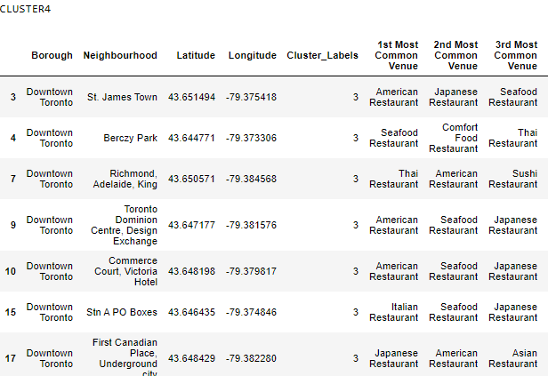
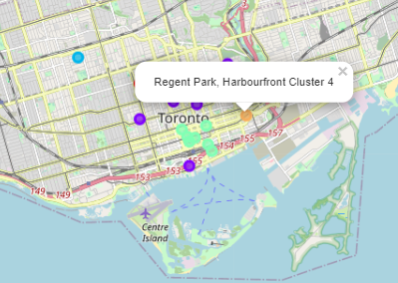
Discussion & recommendation CONTD..
Cluster 4 should be the best choice for American community as most of the neighborhoods are having American restaurants in Top 3 most common venues. Another thing related to our business problem statement is that as this cluster is having many restaurants in all the neighborhoods but an Indian restaurant is not in Top 15 most common venues so Cluster 4 can be considered as one of the choices to open an Indian restaurant.
Cluster 5 is having many restaurants in ‘Regent park’ which is the 4th largest community in terms of population and the 2nd most common language being spoken is ‘Bengali’
In Cluster 5, No Indian restaurant is in top 15 most common venues thus opening an Indian restaurant may attract more population from the neighborhood and hence might yield more revenue and increase in sales.

Slide 15
Conclusion
With the help all the datasets analyzed, Foursquare API was of a great support in extracting valuable insights related to most common and famous venues like bars, restaurants etc. These insights were a great support in analyzing our business problem statement.
By combining all information and performing visualization we were able to Unify variety of restaurants and were mapped with specific Neighborhoods. This could be of a great support for tourists or people who prefer to have Cuisine choices of their countries that they can easily follow clusters of restaurants in their nearby Neighborhoods.
By further analyzing clusters created using Kmeans clustering algorithm and the demographic data, there were certain clusters/neighborhoods identified where there is a business opportunity of opening an Indian restaurant and the recommendation of opening in certain cluster or in certain neighborhood could be followed to yield more revenue and increase in sales.

Slide 16
THANK YOU

